Slide 1
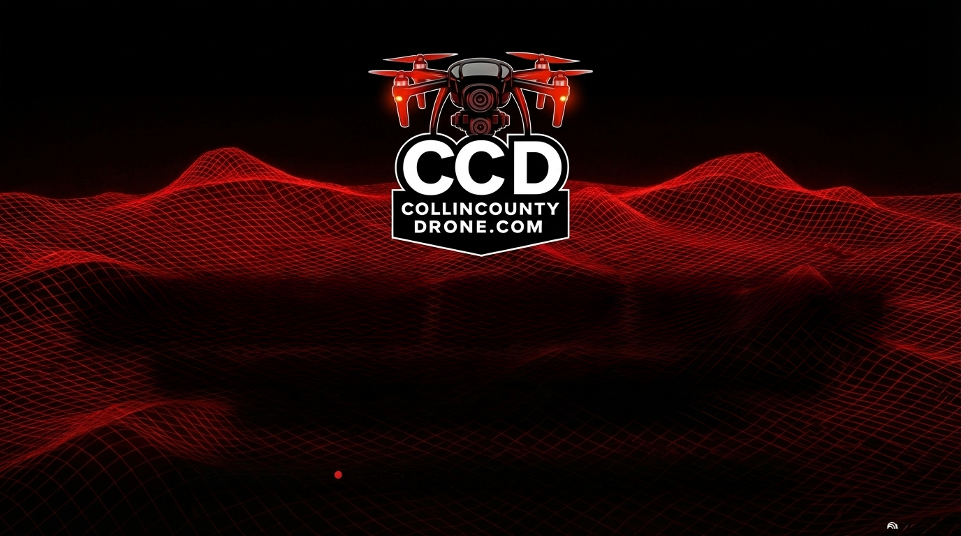
TECHNOLOGY ABOVE THE REST
Delivering centimeter-level aerial precision and
actionable data across North Texas.
Aerial Precision
Local Expertise Serving the DFW Metroplex

Slide 2

Decades of IT
Accelerated Timelines +
Dramatically Reduced
Project Risk
Enterprise-Grade
Sensor Tech
+ Data Rigor & Strict
FAA Compliance
We don't just capture pictures; we deliver exact, centimeter-level truth.
By removing the guesswork from topography, construction, and
municipal planning, we protect your budget and your schedule.

Slide 3
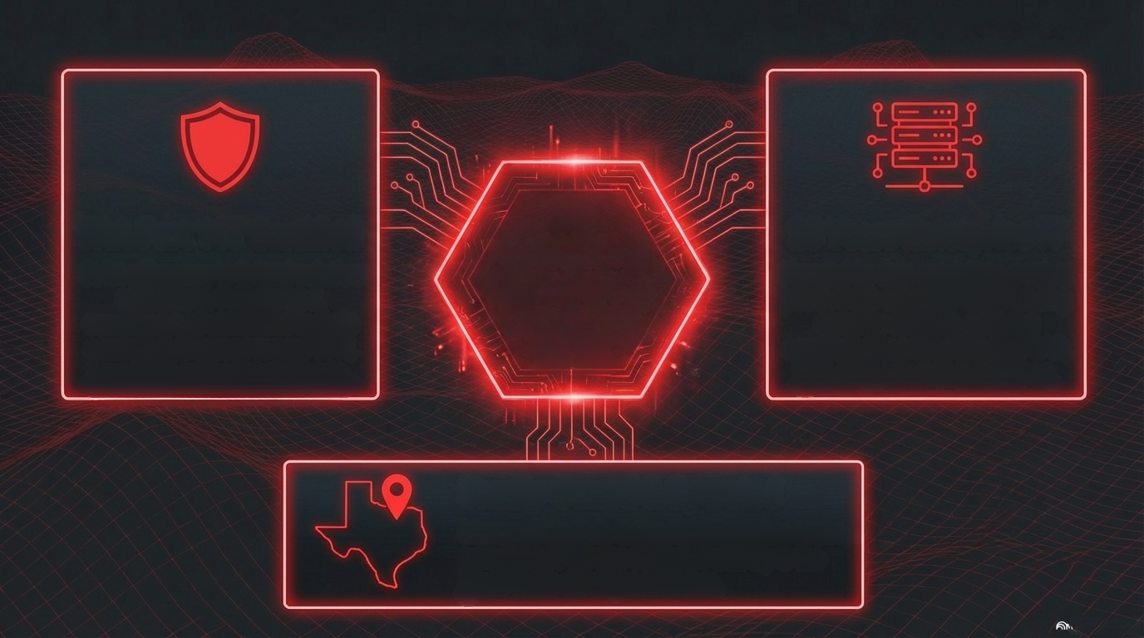
FAA Part 107 Certified
Strict adherence to federal aviation
regulations. Fully insured,
compliant, and authorized to fly in
controlled airspaces around DFW,
Love Field, and regional airports.
Our
Operational
DNA: Safety,
Precision,
Trust.
25 Years Enterprise IT
Founded by data specialists, not just
pilots. Deep expertise in processing
complex datasets, ensuring
seamless integration into your CAD,
BIM, and engineering workflows.
Family-Owned & Operated
Managed locally in Celina, TX. Highly responsive,
personalized service dedicated entirely to the
North Texas development boom.
NotebookLM

Slide 4
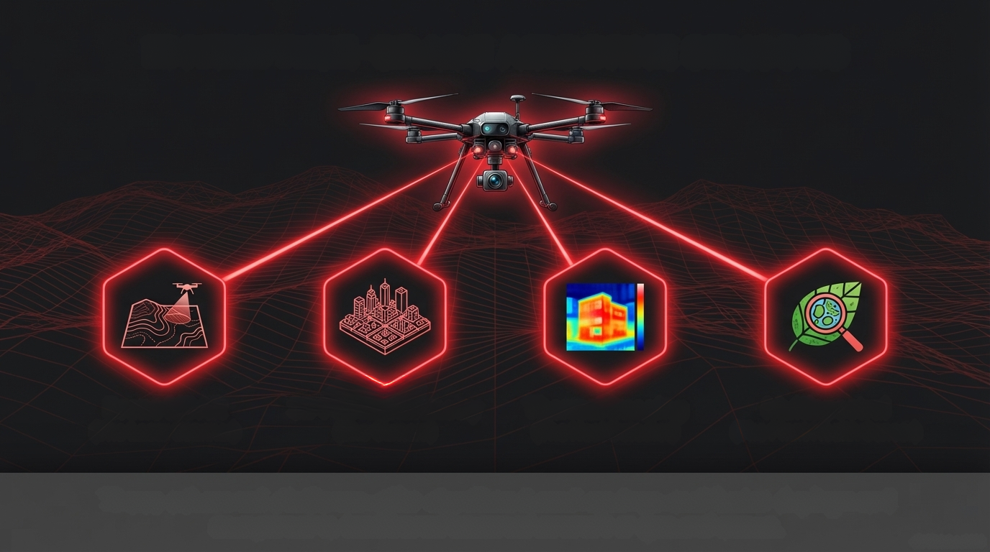
ENTERPRISE-GRADE AIRBORNE SENSORS
Drone LiDAR
(The Laser Scanner)
3D Photogrammetry
Thermal Imaging
(The Heat Detector)
Multispectral
(The Camera)
(The Plant Health Sensor)
These advanced platforms offer significant cost savings and faster deployment
compared to traditional manned aircraft or ground crews.
A NotebookLM

Slide 5
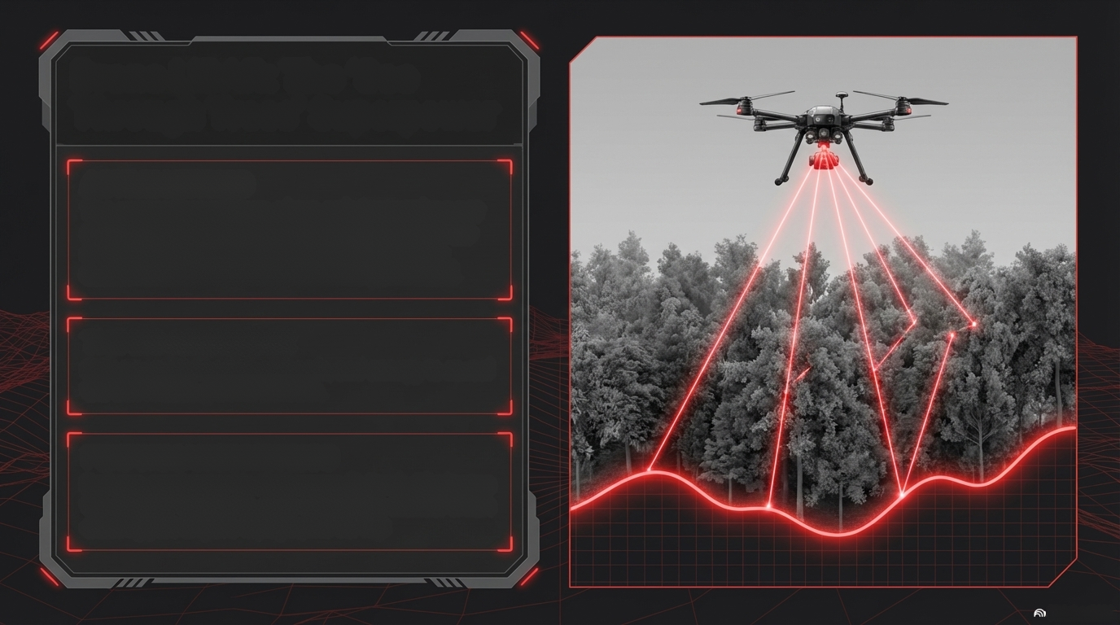
Drone LiDAR: The 'See
Through Trees' Superpower
ACTIVE METHOD
The sensor fires millions of eye-safe laser pulses per
second. Because light travels at a known speed, the
round-trip time translates into an exact distance
measurement, generating a dense 3D point cloud.
THE BIG ADVANTAGE
Strips away dense foliage, brush, and canopy to reveal
the true hidden ground beneath.
PERFORMANCE METRICS
Delivers centimeter-level accuracy (1-5cm). Eliminates
the need for expensive, time-consuming manual brush
clearing just to get a topographic survey.

Slide 6
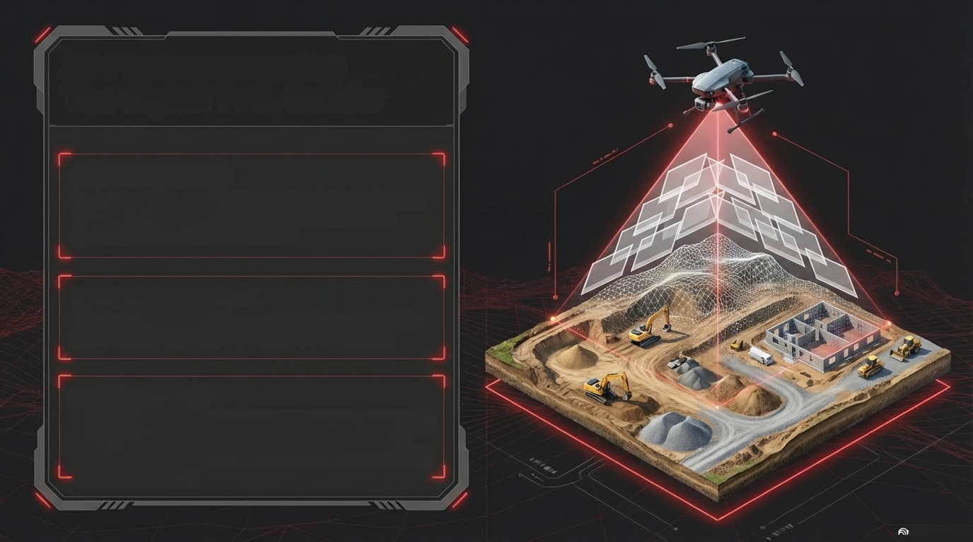
3D Photogrammetry:
The Digital Twin Builder
PASSIVE METHOD
High-resolution, overlapping aerial photographs are
stitched together using specialized software to
reconstruct precise 3D geometry.
THE BIG ADVANTAGE
Creates photorealistic, interactive 3D mesh models
and flat, geometrically corrected orthomosaics.
BEST USE CASE
Highly cost-effective for large open areas, bare-earth
construction sites, and producing stunning visual
records for stakeholder communication and monthly
progress tracking.

Slide 7

Mapping Technologies Compared: LiDAR vs. Photogrammetry
Feature
LiDAR (Active)
Photogrammetry (Passive)
Vegetation Penetration
Biggest Advantage, true
ground DTM.
Struggles, maps the canopy
surface only.
Accuracy & Precision
Edges out, especially for
complex verticality (1-3cm).
Excellent in ideal conditions
and flat terrain.
Works Day/Night, low light, Requires good daylight and
Lighting & Weather
and fog.
stable shadows.
Visual Detail
Outputs grayscale or
colorized point clouds.
Rich, realistic color and
textures.

Slide 8
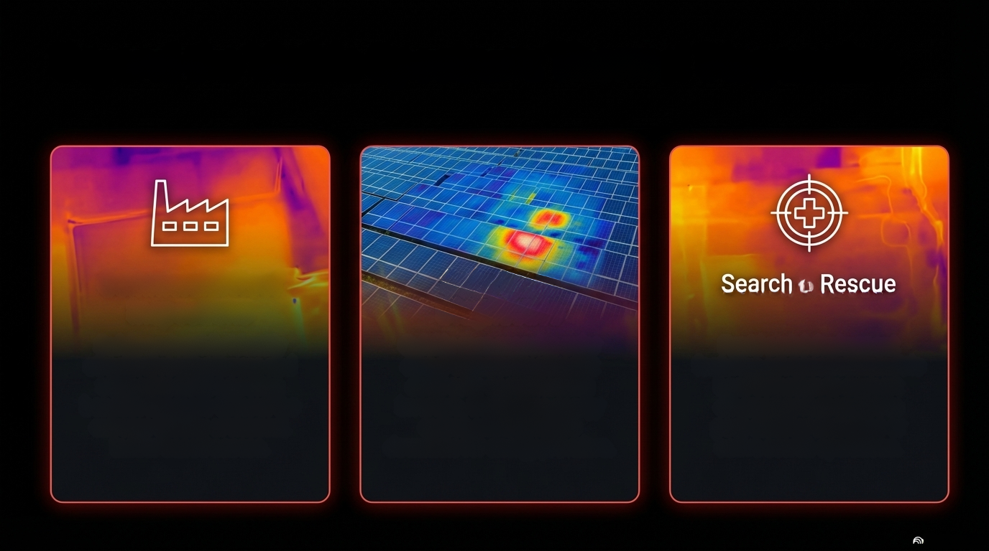
Beyond the Visible Spectrum: Thermal Diagnostics
Commercial Roof
Inspections
Safely and rapidly identify
structural roofing issues and
trapped moisture pooling
beneath flat roofs without the
extreme liability of manual,
ladder-based access.
Solar Farm
Diagnostics
Quickly scan massive solar
arrays to instantly pinpoint
dead cells or overheating
inverters. Maximizes energy
output and minimizes
downtime for energy providers.
Search & Rescue
Rapid aerial deployment
featuring advanced radiometric
heat detection to support
emergency responders in
post-disaster scenarios or
active search operations.

Slide 9
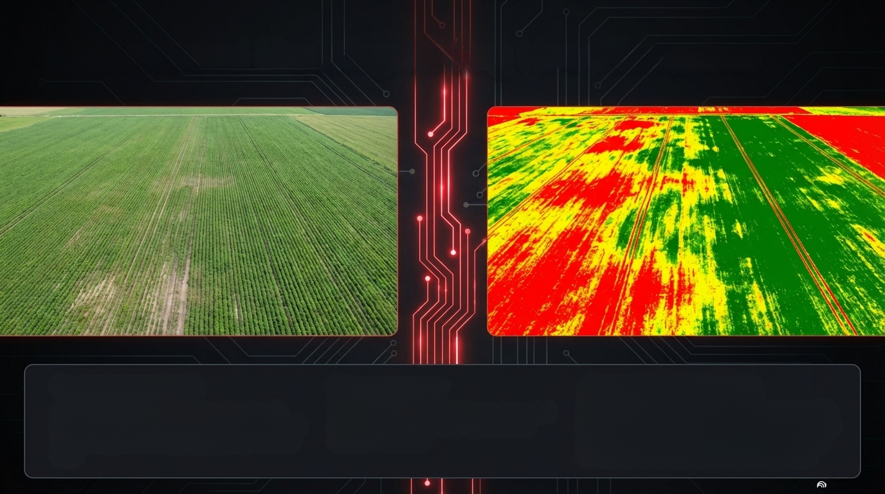
Multispectral Mapping: Seeing How Plants See
THE MECHANISM
M THE INSIGHT
THE BUSINESS VALUE
Detects drought, disease, or pest stress weeks
before it becomes visible on the ground. Drives
precise variable-rate applications, drastically
cutting fertilizer costs and improving yield.
Captures near-infrared light-a wavelength
invisible to human eyes. Healthy plants reflect
a lot of near-infrared light; stressed plants do
not.
Translates invisible light into color-coded
health maps (NDVI) to pinpoint exact
areas of distress.

Slide 10
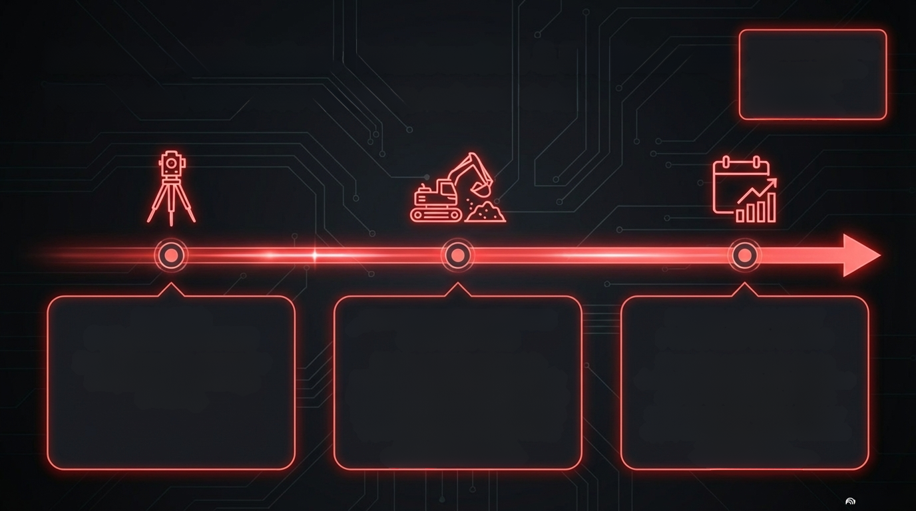
Industry Application: Construction & Engineering Delivering actionable
Faster data, enhanced accuracy, reduced risks.
insights to local
developments.
PHASE 1:
PRE-CONSTRUCTION
Rapid topographic surveys for
site planning and drainage
modeling.
PHASE 2: EARTHWORKS
& STOCKPILES
Highly accurate volumetric
measurements. Calculate exactly
how much dirt was moved or how
much gravel is in a stockpile with
1-3% accuracy. Safer and faster
than ground crews.
PHASE 3: MONTHLY
PROGRESS TRACKING
Bi-weekly or monthly flights
delivering complete orthomosaics
and 3D fly-throughs. Project
managers verify contractor pay
apps; developers use 3D models
to thrill buyers.

Slide 11
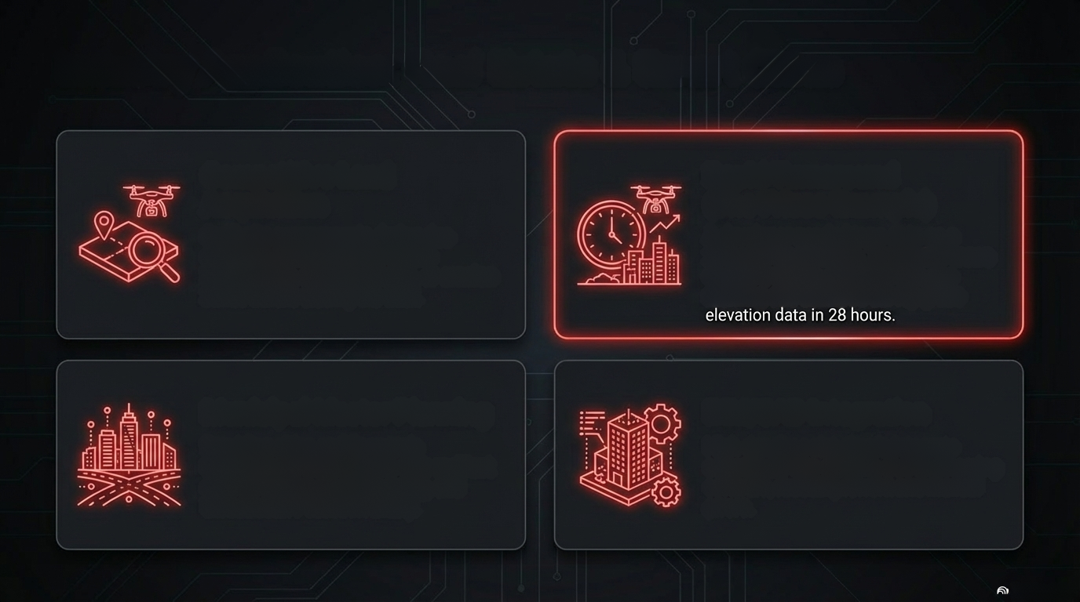
Industry Application: Real Estate & Smart Cities
Competitive Land
Acquisition
Swift site assessments during due
diligence. Identify hidden terrain
irregularities, drainage issues, or erosion
zones before closing the deal.
Rapid Turnaround
(The Frisco Example)
A developer needed topo data on a
200-acre wooded site. Traditional crews
quoted 3 weeks. CCD flew it in one
morning and delivered survey-grade
elevation data in 28 hours.
Municipal Master Planning
Providing cities and Economic
Development Corporations with resilient
data for zoning, flood modeling, and
infrastructure asset inventory.
BIM/CAD Integration
High-density point clouds integrate
seamlessly into existing civil engineering
software, reducing rework and manual
errors.

Slide 12
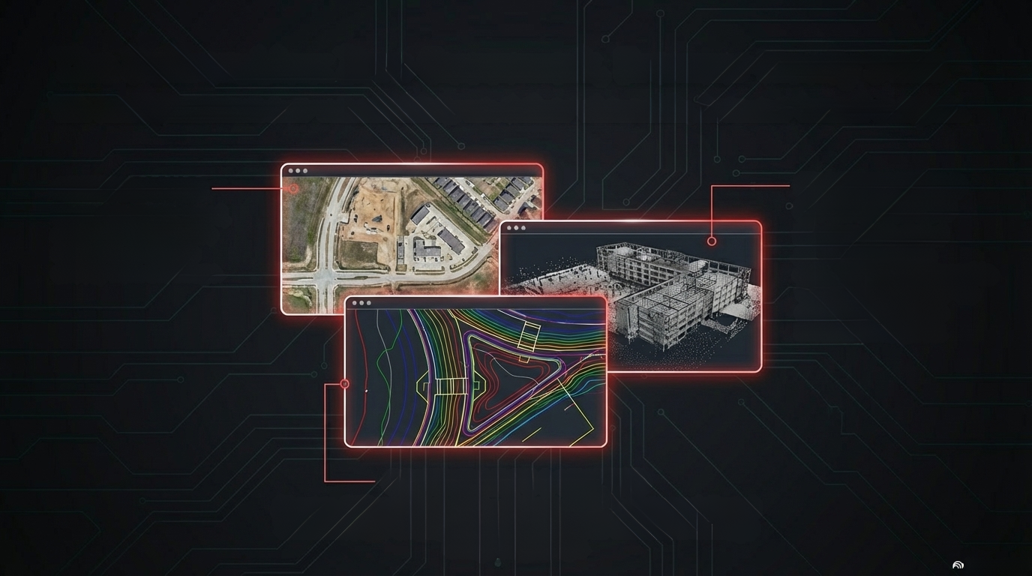
The Deliverables: Zero Guesswork, Browser-Ready Data
We don't just hand over a hard drive; we deliver shareable, browser-based insights.
ORTHOMOSAICS
Geometrically corrected,
scaled maps. Measure
distances and areas
directly from the image.
3D MESH MODELS
& POINT CLOUDS
Photorealistic digital
replicas and dense
coordinate grids. Shareable
via a simple web link-no
specialized software
installation required.
CONTOUR MAPS & VOLUMES
Direct-to-CAD engineering data. 1-foot to 0.5-foot contours delivered
in standard DXF or Shapefile formats, ready for immediate drainage
and grading design.

Slide 13

Our Process: Fast, Compliant, and Frictionless
1
2
3
Consult, Plan
& Authorize
Ground Control
& Flight
Process
& Deliver
We assess your project needs,
calculate flight lines for optimal
data density, and handle
100% of the FAA airspace
authorizations (critical for
DFW and Love Field zones).
We place surveyed ground
control points across your site
to tie aerial data to real-world
coordinates, ensuring true
engineering-grade accuracy.
We fly the mission safely.
Data processing turnaround
is measured in hours or days,
not weeks. Final assets are
delivered securely via cloud
platforms for immediate
team collaboration.

Slide 14

Project Diagnostic: Which Technology Do You Need?
SCENARIO: Raw land survey with
heavy trees or brush.
SOLUTION: Drone LiDAR
(To penetrate the canopy for a true
bare-earth model).
SOLUTION: 3D Photogrammetry
(Highly cost-effective with stunning visual
documentation).
SCENARIO: Large, open
construction site needing volume
calculations.
SCENARIO: Massive flat
commercial roof
post-hailstorm.
SOLUTION: Thermal Imaging
(To instantly detect hidden water
pooling).
SCENARIO: 500-acre agricultural
field with irregular yield.
SOLUTION: Multispectral
(To create an NDVI health map for variable
rate application).
NotebookLM

Slide 15

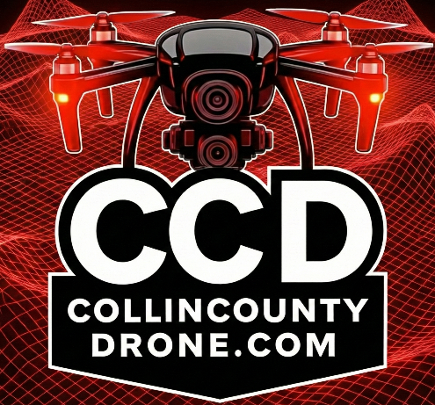
ELEVATE YOUR NEXT PROJECT
Connect with our team to schedule a custom aerial
imaging consultation. We don't push services you
don't need; we deliver precise data that drives decisions.
Phone: 972-314-9500
Email: info@collincountydrone.com
Web: collincountydrone.com

